Slide 1

Data Mavericks
Vipul Puttaswamy Gowda
Raghuram Gudemaranahalli Nataraja
Siddhanth Darshan Jain Gouder Nagpal
Jathin Varma Muthineni
Portland State University
Maseeh College of Engineering
Computer Science Department
CS410/510 - Data Engineering
Professor: Bruce Irvin
TA: Vysali Kallepalli

Slide 2
System Description
Hello everyone, We are excited to share our project that enhances public transportation in Portland, Oregon, through advanced data analysis. We've developed a robust system that processes data from TriMet, which is the agency responsible for most public transit services in the region. Our system specifically analyzes 'breadcrumb' data, a term used to describe the GPS tracking information that's recorded by TriMet buses using GPS receiver connected to a cellular or satellite modem, which transmits the data in real-time to a central server over wireless networks.. These breadcrumbs provide real-time data on the location, speed, and direction of buses throughout their routes.
Our system captures this breadcrumb data along with details on bus stops known as stop events to display a comprehensive picture of how buses operate throughout the day. By analyzing this information, we can identify areas where bus service might be lagging, such as routes with frequent delays or overcrowding, and suggest improvements. The goal is to make public transit more efficient, reliable, and user-friendly, ultimately enhancing the commuting experience for thousands of residents and visitors in Portland.
Siddhanth

Slide 3
Technical Overview of the Data Pipeline
Data Acquisition: Our automated system fetches the breadcrumb and stop event data daily from TriMet’s API, which provides the GPS details and stop event details for buses based on specified vehicle IDs.
Data Ingestion and Streaming: Leveraging Google Cloud Platform, we've set up a robust infrastructure where data is streamed via Google Cloud Pub/Sub facilitated by a publisher script written in Python. Each batch of data, which encompasses one day's worth of data for each vehicle ID, is already recorded and stored in the TriMet database.This data is accessed via an API, with retrieval scheduled through cron jobs to run daily at 20:00.
Data Processing: Once collected, the data undergoes several stages:
Validation: Ensures accuracy and completeness of the data.
Transformation: Adjusts data formats and computes additional metrics, such as deriving speed from sequential GPS points.
Enhancement: Enriches the data by integrating breadcrumb data with stop event data, providing a more granular view of each trip.
Data Storage and Management: Processed data is stored in a PostgreSQL database, designed with a schema that supports complex queries and efficient data retrieval.
Data Visualization and Analysis: We utilize Mapbox GL to create dynamic visualizations that map bus routes and operational metrics like speed directly onto a geographical representation of Portland. This allows us to analyze patterns such as speed variations and route efficiency.
Siddhanth

Slide 4
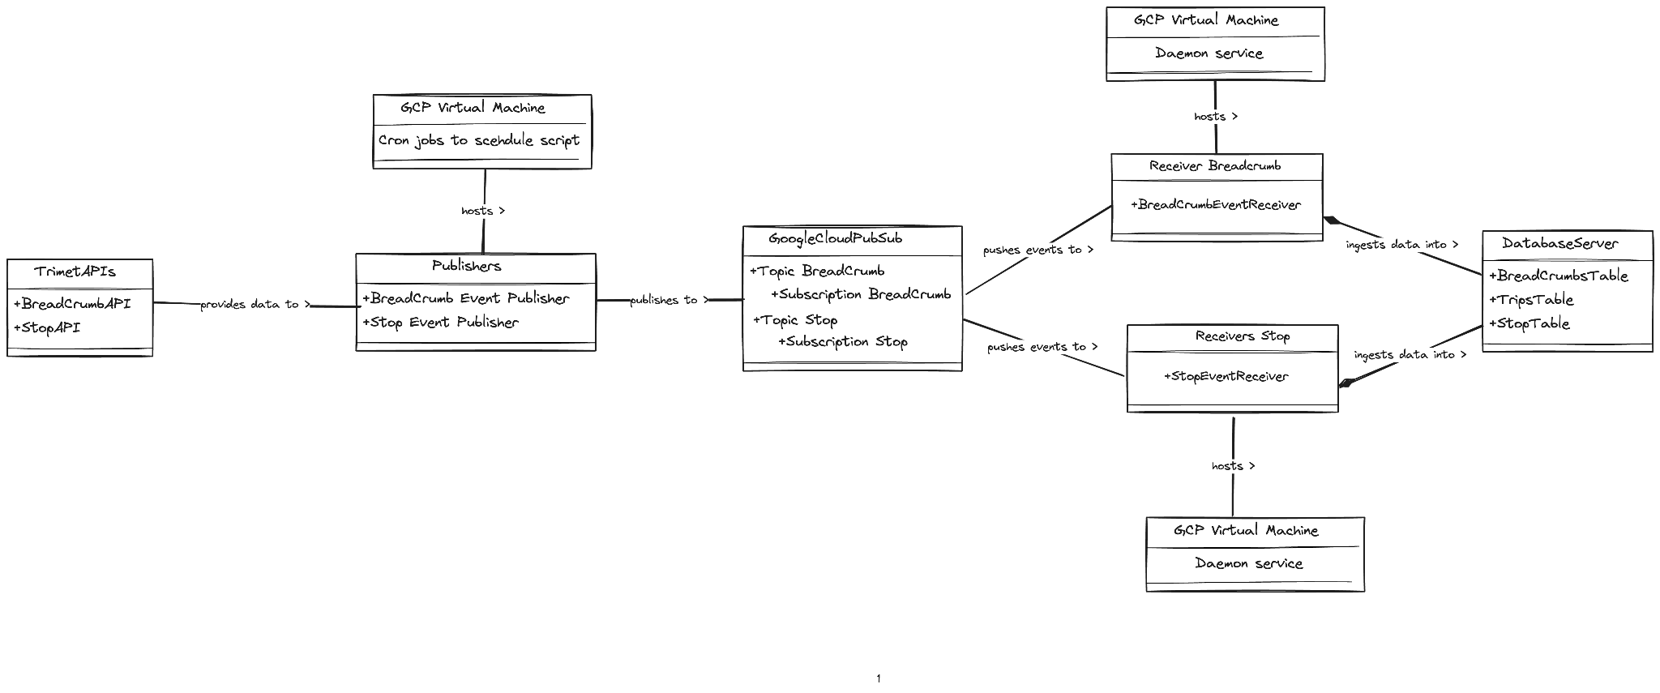
Component Diagram
Siddhanth

Slide 5
System Architecture Overview
Data Source
TriMet APIs: We leverage two APIs:
Breadcrumb API: Provides GPS coordinates and timestamps from buses at 5-second intervals.
Stop Events API: Offers details about bus stop times and durations.
Google Cloud Platform (GCP) Virtual Machines
Data Collection VMs: These VMs are configured with Python scripts that run on a scheduled basis (via cron jobs) to pull data from the TriMet APIs. These scripts use the requests library to handle HTTP requests and parse JSON payloads.
Data Processing VMs: Post-data collection, these VMs handle heavy data processing tasks. This includes data cleaning, validation using custom Python functions, and transformation tasks like calculating velocities from consecutive GPS points.
Publisher
Data Publishing Services: Implemented in Python, these services utilize the google-cloud-pubsub library to publish data to designated topics within the Google Cloud Pub/Sub system. Each piece of data is formatted as a JSON message and includes metadata like collection timestamps and data source identifiers.
Google Cloud Pub/Sub System
Topics and Subscriptions: We have separate topics for breadcrumb and stop event data to segregate the data flows. Subscriptions are configured with message retention policies and dead-letter handling to manage data delivery reliability.
Receivers
Data Receiver Services: These are also Python-based applications subscribing to the Pub/Sub topics. They perform additional validations (e.g., checking for duplicate data entries) and transformations (e.g., converting timestamps to a unified timezone). The receivers then load the data into the PostgreSQL database using batch inserts to optimize performance.
Database Server
PostgreSQL on GCP: Our database schema is optimized for time-series data analysis, with tables structured to efficiently query spatial and temporal data. We use indices on trip IDs, timestamps, and geographical coordinates to speed up queries.
Siddhanth

Slide 6
Detailed Overview - Infrastructure
Google Cloud Virtual Machines (VMs):
VM Utilization: We deploy Python scripts on optimized Google Cloud Platform Virtual Machines to fetch data from TriMet APIs, ensuring high availability for data processing.
VM Scheduling: To align with processing demands and enhance cost efficiency, VMs are scheduled to run daily from 19:50 to 21:30, minimizing operational costs while ensuring availability during critical hours.
Google Cloud Pub/Sub:
The system employs GCP Pub/Sub for robust, real-time messaging across different components. Using distinct topics for breadcrumb and stop event data ensures organized, manageable, and scalable data flows, essential for efficient large-scale data handling.
Cron Job Scheduling:
Cron jobs on GCP VMs automate the execution of data-fetching and publishing scripts, specifically scheduled to run after VM startup. The runscript.sh triggers these operations at 20:00 daily, aligning perfectly with the VMs' operational window to ensure data is updated regularly without manual input.
Daemon for Persistent Services:
Daemon processes manage the persistence and reliability of our data processing applications. Services such as trimet-receiver.service are configured to automatically initiate with the VM and restart upon failure, ensuring continuous data processing without interruptions.
Logging and Monitoring with GCP Services:
Operational logging is integral for monitoring system performance and troubleshooting. Utilizing GCP Logging services, logs are systematically captured and stored both in a local file (log_file.log) and in the cloud. This dual storage approach ensures comprehensive visibility into system health and operational metrics, facilitating real-time analysis and historical data review.
Raghuram

Slide 7
Detailed Overview - Publisher
Data Fetching:
Breadcrumb and Stop event publisher scripts operate asynchronously, utilizing aiohttp.ClientSession to make non-blocking HTTP requests to the TriMet APIs. This ensures efficient data retrieval without idling resources.
The breadcrumb data script fetches GPS coordinates and timestamps for buses, which detail their routes and movements at 5-second intervals.
The stop event data script retrieves data about bus stops, including arrival and departure times, which are extracted from HTML content using BeautifulSoup.
Data Processing and Transformation:
Breadcrumb Data: After fetching, each GPS record is serialized into JSON and immediately published to a specific Pub/Sub topic dedicated to breadcrumb events.
Stop Event Data: The HTML content is parsed to extract relevant data, convert it into structured formats using pandas, and then serialize it into JSON. This data includes additional context like trip IDs and precise timestamps, enhancing the richness of the dataset.
Data Publishing:
Both scripts use google.cloud.pubsub_v1.PublisherClient to connect to Google Cloud Pub/Sub.
Breadcrumb and stop event data are published to separate topics (trimet-topic for breadcrumbs and trimet-stop-topic for stop events). This segregation helps in managing data flow and allows for tailored processing downstream.
Error Handling and Resilience:
The scripts include error handling to manage issues such as API unavailability or data inconsistencies. For instance, they handle HTTP 404 errors gracefully by logging and skipping missing data without breaking the execution flow.
Exception handling mechanisms ensure that any unexpected errors are logged, providing traceability and aiding in quick resolution.
Raghuram

Slide 8
Detailed Overview - Receiver
Message Handling:
The system employs Google Cloud Pub/Sub, a fully managed real-time messaging service, to receive and manage streams of data from two separate topics. Each topic corresponds to a distinct type of data: trimet-topic for GPS breadcrumb data and trimet-stop-topic for stop event data. Python-based receiver scripts are tasked with subscribing to these topics, ensuring real-time data capture.
Data Reception and Asynchronous Processing:
Upon reception, data is processed asynchronously to maintain throughput and minimize latency. The pubsub_v1.SubscriberClient in Python handles data fetching, while asynchronous callbacks process and validate each message:
For breadcrumb data, transformations include computing speeds from sequential GPS entries and normalizing timestamp data to a consistent timezone.
For stop events, data extracted from JSON payloads is reformatted, with timestamps converted to standard datetime objects and categorical data like direction converted from codes to descriptive labels.
Data Validation Techniques - Anomaly detection:
Type and format assertions ensure that each data field matches the expected data types and formats. For example, checking that numeric fields like GPS coordinates are actual numbers and that timestamp fields conform to a specific datetime format.
Range assertions are used to verify that data values fall within acceptable ranges. For GPS data, this would include ensuring latitude values are between -90 and 90 degrees and longitude values are between -180 and 180 degrees. Timestamps would also be checked to ensure they are within a realistic and expected operational window.
For fields where negative values do not make sense (such as speed or distance measurements), assertions ensure that these values are non-negative. This helps in identifying data entry errors or anomalies in sensor readings.
Data Completeness verify that no essential data elements are missing from any record. Ensuring that fields like GPS coordinates, vehicle IDs, and timestamps are present in every data entry is crucial for the integrity and usability of the data.
Assertions detect duplicate records within the dataset, ensuring that each entry is unique and thereby maintaining the accuracy and reliability of the data. This is particularly important in systems where duplicate data can lead to skewed analysis or operational insights.
Raghuram

Slide 9
Detailed Overview - Receiver
Speed Calculation and Data Transformation:
For breadcrumb data, the receivers calculate the speed of buses by measuring the distance between consecutive GPS points and dividing by the time interval, applying the formula speed=distance / time. This calculation is performed dynamically as data streams into the system, providing real-time insights into bus speeds.
Comprehensive Error Handling and System Monitoring:
Our system utilizes structured exception handling frameworks across all stages of data processing and loading. These frameworks systematically log errors to prevent data corruption and ensure quick resolution. Integrated directly into the receivers, this comprehensive approach manages exceptions effectively during data fetching, processing, and loading, enhancing the system’s resilience.
Efficient Data Insertion into PostgreSQL:
Using the psycopg2 library's copy_from method, the receivers efficiently load data into PostgreSQL by leveraging batch processing techniques. This approach, chosen for its ability to handle large data batches, significantly reduces database transaction overhead. By aggregating data into batches prior to insertion, our system enhances overall performance and minimizes processing times, ensuring robust data management even under conditions of high data influx.
Automation and System Maintenance:
Automation scripts manage the lifecycle of daemon services, including scheduled checks and restarts to ensure system resilience. The overall system architecture is designed for minimal human intervention, with automated recovery strategies.
Raghuram

Slide 10
Detailed Overview - Data Storage
The database schema provided outlines a relational structure optimized for storing GPS breadcrumb and stop event data associated with public transit systems, specifically designed for robust querying and data integrity. Here’s a detailed look at the storage layer described by the tables breadcrumb, stop, and trip:
Table Descriptions:
Breadcrumb Table:
This table captures real-time GPS data for transit vehicles.
Columns:
tstamp: Timestamp of the GPS record, indicating when the data was recorded.
latitude and longitude: GPS coordinates detailing the vehicle's position.
speed: Vehicle's speed at the time of the GPS record.
trip_id: A foreign key linking the breadcrumb to a specific trip in the trip table.
Stop Table:
Stores data related to transit stops for each vehicle trip.
Columns:
vehicle_number: Identifier for the vehicle.
trip_id: Links stop data to the specific trip.
stop_time, leave_time, arrive_time: Timestamps marking various events at each stop.
route_id, direction, service_key: Additional descriptors of the trip, such as the route, direction of travel, and type of service.
maximum_speed, train_mileage: Performance metrics recorded at stops.
dwell, location_id, door, lift, ons, offs, estimated_load: Operational metrics such as dwell time, stop location, door and lift usage, passenger counts boarding and alighting, and the estimated load after the stop.
Jathin

Slide 11
Detailed Overview - Data Storage
Trip Table:
Central table linking both breadcrumb and stop tables.
Columns:
trip_id: Primary key, uniquely identifying each trip.
route_id: Identifies the route of the trip.
vehicle_id: Identifier for the vehicle used on the trip.
service_key, direction: Descriptors categorizing the trip type and direction.
Relationships:
Acts as a central hub with foreign key constraints linking it to both breadcrumb and stop tables via trip_id, ensuring data across tables is consistently related to specific trips.
Jathin

Slide 12
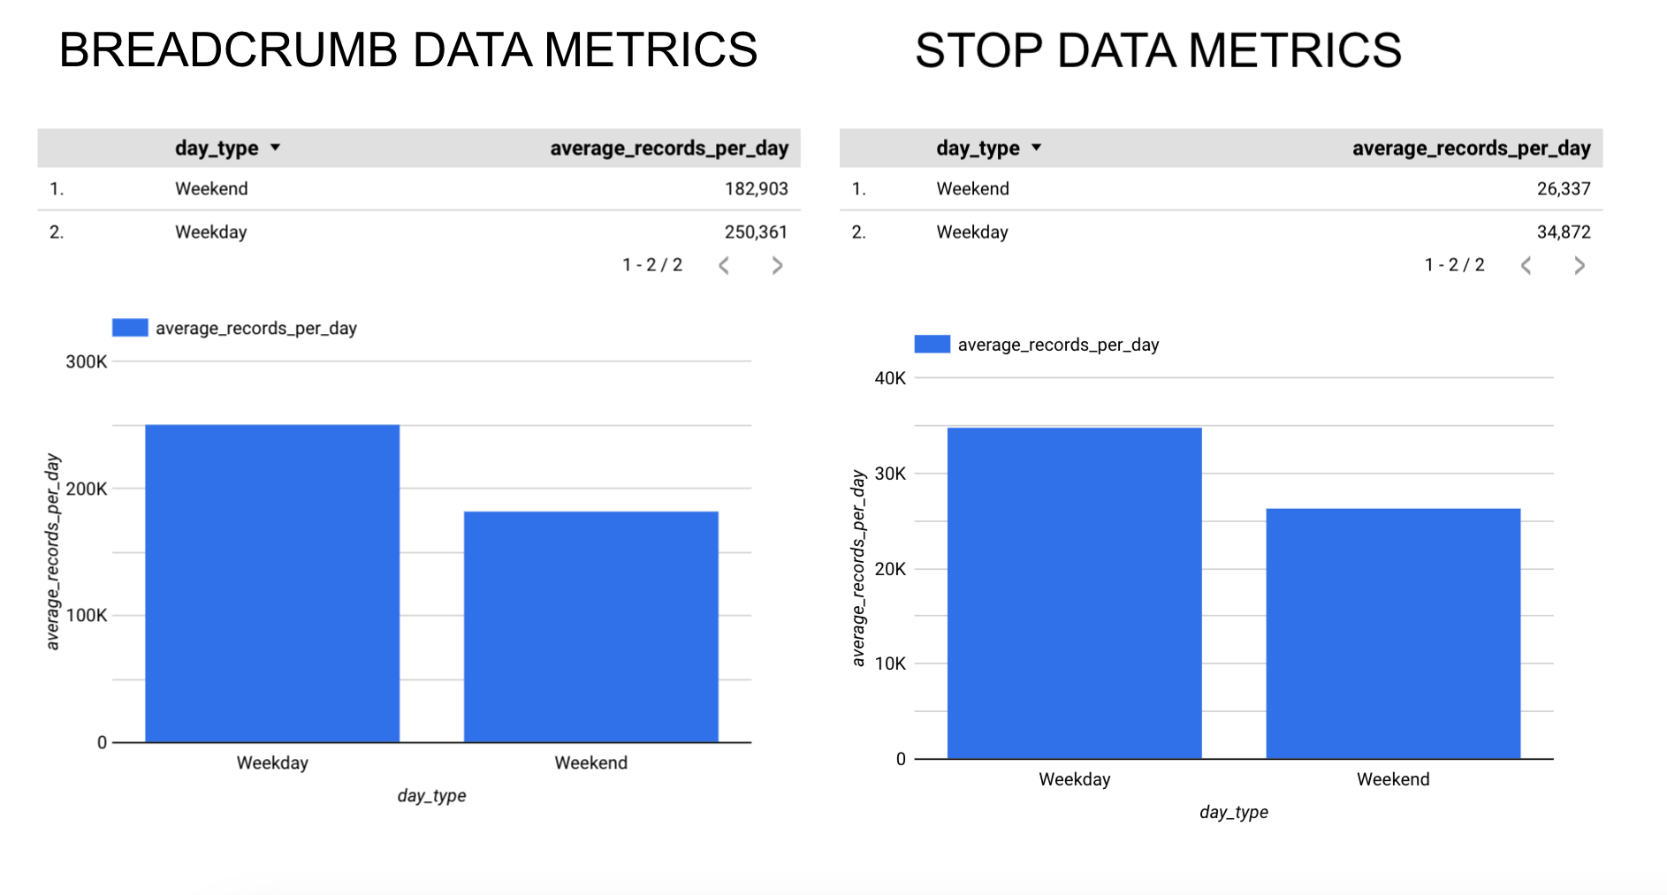
Some Interesting data using Looker Studio
Jathin

Slide 13
Exploring Transit Data
Vast Data Collection: Our dataset comprises a substantial 307.1 Mb of breadcrumb trail data, which captures the intricate movements of transit vehicles across the network.
Record Entries: An impressive total of 5,719,379 records have been collected via the Breadcrumb API, providing a granular view of transit operations.
Detailed Stop Insights: We've accumulated 65.2 Mb of stop data, ensuring precise tracking of vehicle stops throughout the transit system.
Comprehensive Event Tracking: The Stop Events API has furnished us with 585,035 records, each documenting critical stop-related events.
Diverse Journey Mapping: Our dataset is enriched with information on 14,832 unique trips, highlighting the extensive coverage and complexity of transit routes.
Jathin

Slide 14
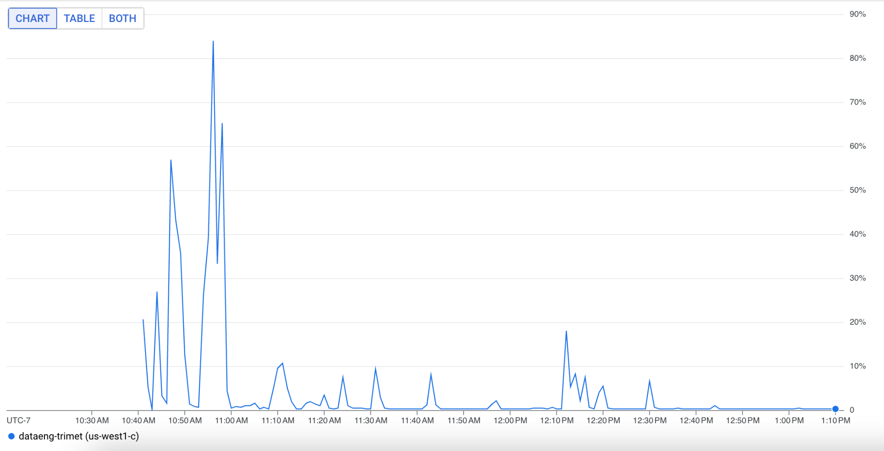
CPU Utilization
Jathin

Slide 15
Data Visualization - 1
Identify the vehicle with most trips and display detailed information about those trips.
Data Overview:
Records Collected: 35,487
Trips Completed: 178
Data Period: January 22, 2023, to February 8, 2023 - spanning 18 days
10750 passengers travelled in this vehicle during the time period.
Vehicle 3420 not only performed more trips but likely encountered diverse operational scenarios, providing us a rich dataset for analysis.Analysis of trip durations, speed variations across different segments, and passenger load during various times of the day gives us a window into the vehicle’s efficiency and areas needing attention.
Vipul

Slide 16
Data Visualization - 1 - Query
WITH CombinedRecords AS (
-- Select breadcrumb data
SELECT
'Breadcrumb' AS record_type,
b.tstamp AS event_time,
t.route_id,
t.trip_id,
t.vehicle_id,
b.latitude,
b.longitude,
b.speed,
NULL AS train_mileage, -- Placeholder for stop data
NULL AS estimated_load -- Placeholder for stop data
FROM
trip t
JOIN
breadcrumb b ON t.trip_id = b.trip_id
UNION ALL
-- Select stop data
SELECT
'Stop' AS record_type,
s.stop_time AS event_time,
t.route_id,
t.trip_id,
t.vehicle_id,
NULL AS latitude, -- Initially null, to be updated
NULL AS longitude, -- Initially null, to be updated
0 AS speed, -- Placeholder for breadcrumb data
s.train_mileage,
s.estimated_load
FROM
trip t
JOIN
stop s ON t.trip_id = s.trip_id
),
UpdatedRecords AS (
SELECT
record_type,
event_time,
route_id,
trip_id,
vehicle_id,
COALESCE(latitude, LAG(latitude) OVER (PARTITION BY trip_id ORDER BY event_time)) AS latitude,
COALESCE(longitude, LAG(longitude) OVER (PARTITION BY trip_id ORDER BY event_time)) AS longitude,
speed,
train_mileage,
estimated_load
FROM
CombinedRecords
),
VehicleTripCounts AS (
-- Step 1: Count the number of trips for each vehicle
SELECT
vehicle_id,
COUNT(DISTINCT trip_id) AS trip_count
FROM
UpdatedRecords
where route_id > 1
GROUP BY
vehicle_id
ORDER BY
trip_count DESC
LIMIT 1 -- Limit to the vehicle with the most trips
),
VehicleTravelData AS ( -- Step 3: Get the travel locations for the top vehicle trips
SELECT
b.vehicle_id,
b.trip_id,
b.route_id,
b.latitude,
b.longitude,
b.estimated_load,
b.train_mileage,
b.speed,
b.event_time as tstamp
FROM UpdatedRecords b WHERE b.trip_id IN (
SELECT
t.trip_id
FROM
UpdatedRecords t
JOIN
VehicleTripCounts vtc ON t.vehicle_id = vtc.vehicle_id
WHERE t.route_id > 1
)
)
SELECT -- Final Selection: Get vehicle travel data ordered by vehicle, trip, and timestamp
longitude,
latitude,
speed, -- Convert speed of 0 to NULL
vehicle_id,
trip_id,
route_id,
tstamp,
estimated_load,
train_mileage
FROM
VehicleTravelData
WHERE
latitude IS NOT NULL -- Exclude rows with NULL latitude
AND longitude IS NOT NULL -- Exclude rows with NULL longitude
ORDER BY
tstamp, trip_id; -- Order by timestamp and trip_id
Vipul

Slide 17
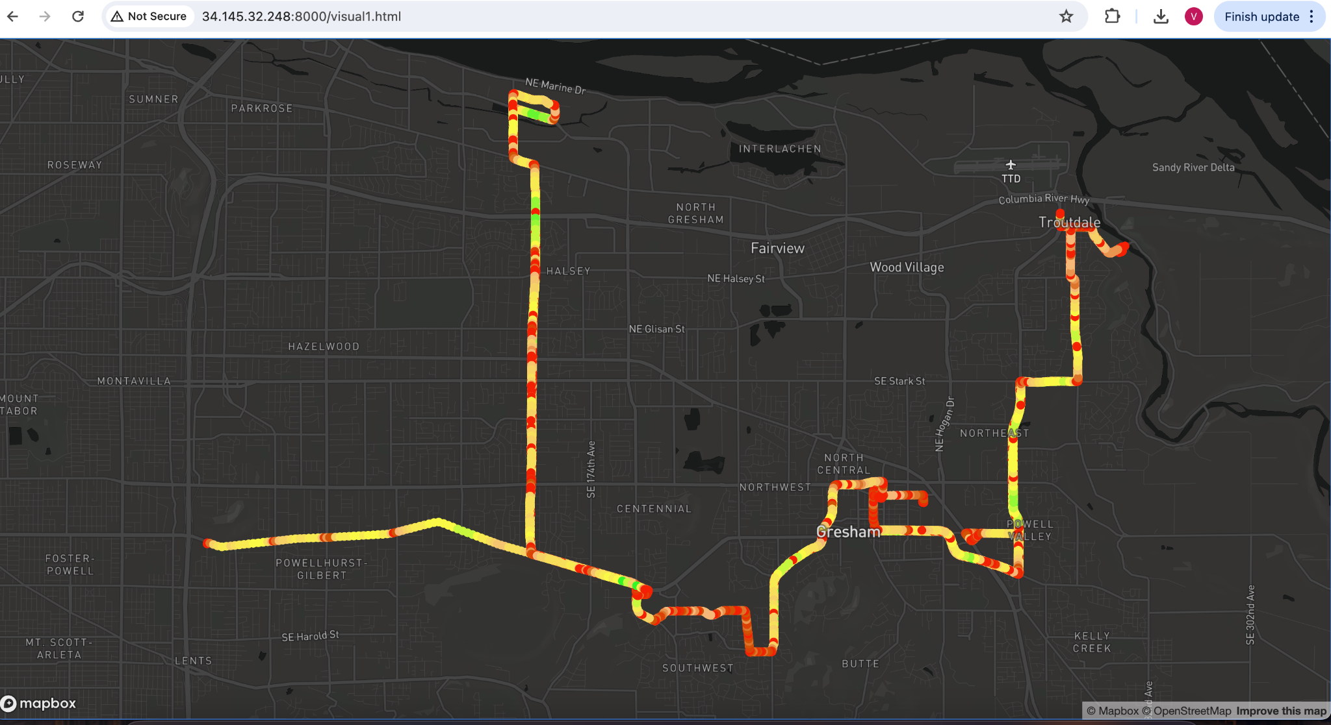
Data Visualization - 1
Vipul

Slide 18
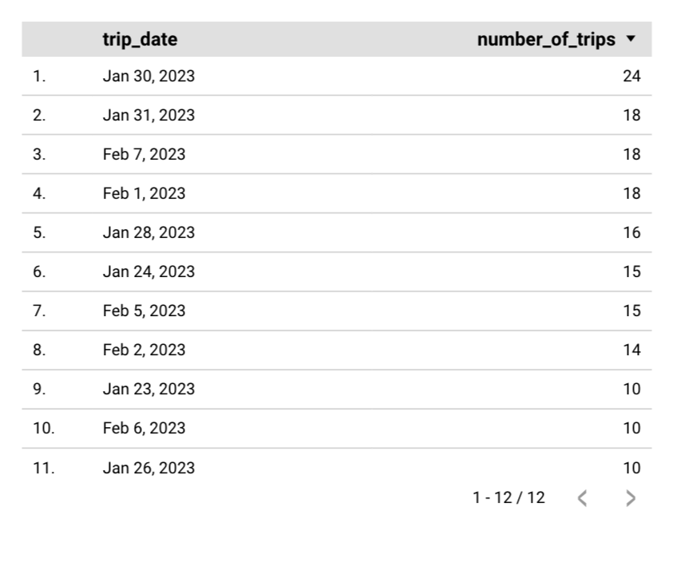
Data Visualization - Insights
The vehicle ID - 3420 had most number of trips on Jan 30th 2023 which is Monday.
Most trips are during weekdays than weekends.
NE Wood Ave is very slow moving as vehicle speeds are less than average.
Route 74 had unusual trip on Jan 24th 2023 with no Passengers which started from SE 99th Ave.
Vipul

Slide 19
Data Visualization - 2
Identify trips with maximum number of passengers and display detailed information about those trips
Data Overview
15 trips had estimated average of more than 23 passengers.
7672 records were collected from this 15 trips.
Route 72 has highest breadcrumb recorded which mean it is most travelled.
Data Period: January 22, 2023, to February 8, 2023 - spanning 18 days
14 Vehicles travelled during this duration with 3148 Vehicle travelling twice.
Vipul

Slide 20
Data Visualization - 2 - Query
WITH CombinedRecords AS (
-- Select breadcrumb data
SELECT
'Breadcrumb' AS record_type,
b.tstamp AS event_time,
t.route_id,
t.trip_id,
t.vehicle_id,
b.latitude,
b.longitude,
b.speed,
NULL AS train_mileage, -- Placeholder for stop data
NULL AS estimated_load -- Placeholder for stop data
FROM
trip t
JOIN
breadcrumb b ON t.trip_id = b.trip_id
UNION ALL
-- Select stop data
SELECT
'Stop' AS record_type,
s.stop_time AS event_time,
t.route_id,
t.trip_id,
t.vehicle_id,
NULL AS latitude, -- Initially null, to be updated
NULL AS longitude, -- Initially null, to be updated
0 AS speed, -- Placeholder for breadcrumb data
s.train_mileage,
s.estimated_load
FROM
trip t
JOIN
stop s ON t.trip_id = s.trip_id
),
UpdatedRecords AS (
SELECT
record_type,
event_time,
route_id,
trip_id,
vehicle_id,
COALESCE(latitude, LAG(latitude) OVER (PARTITION BY trip_id ORDER BY event_time)) AS latitude,
COALESCE(longitude, LAG(longitude) OVER (PARTITION BY trip_id ORDER BY event_time)) AS longitude,
speed,
train_mileage,
estimated_load
FROM
CombinedRecords
),
TripAverageLoad AS (
-- Compute the average estimated load for each trip
SELECT
trip_id,
route_id,
vehicle_id,
AVG(estimated_load) AS average_estimated_load
FROM
UpdatedRecords
WHERE
estimated_load IS NOT NULL -- Only consider rows where estimated_load is available
GROUP BY
trip_id, route_id, vehicle_id
)
Select
longitude,
latitude,
speed,
vehicle_id,
trip_id,
route_id,
event_time,
estimated_load,
train_mileage
from UpdatedRecords WHERE trip_id IN (
SELECT
DISTINCT trip_id
FROM
TripAverageLoad
WHERE
average_estimated_load > 23
) AND latitude IS NOT NULL -- Exclude rows with NULL latitude
AND longitude IS NOT NULL -- Exclude rows with NULL longitude
ORDER BY
event_time, trip_id, vehicle_id;
Vipul

Slide 21
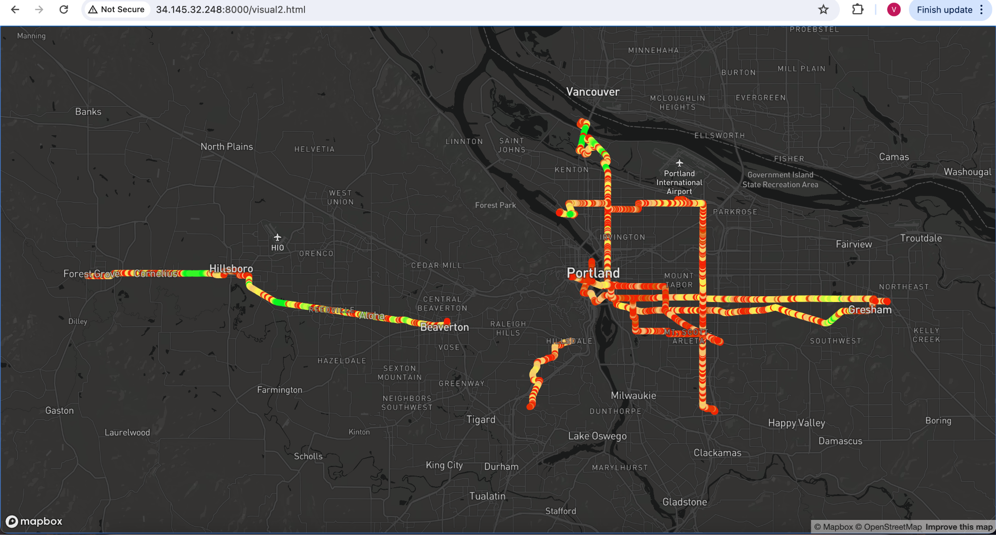
Data Visualization - 2
Vipul

Slide 22
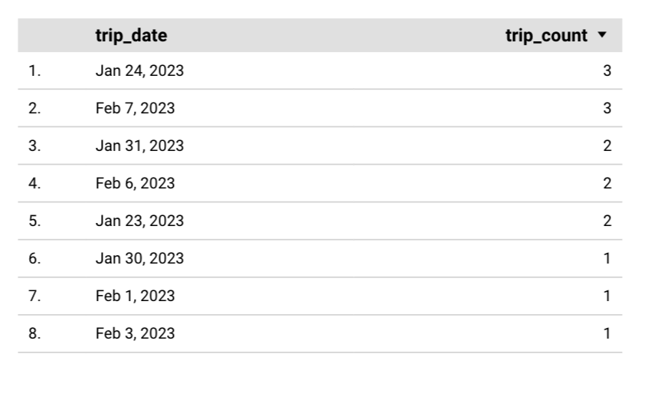
Data Visualization - Insights
Jan 24, Feb 7 and Jan 31st all are tuesdays where most trips are which means most passengers travelled on this day.
On 7th Feb 2023, which usually travels from PCC Sylvania to St Johns but on this particular day, it stopped at Hillsdale.
Downtown Portland has slow moving traffic.
Cascadia Gardens, Hayden Island and Hollybrook places have low traffic and faster movements of vehicles.
Vipul

Slide 23
Challenges
Deleting the VM during the mid of the course. This had us in the first half and later learnt few lessons about VM backups.
Human errors are inevitable, often unpredictable, and can be both a source of amusement and a learning opportunity in any complex project.
Data Engineering is all about understanding the needs and challenges that will help good data engineer design better systems and make you a more effective engineer.
In Data engineering, things will go wrong—servers crash, data gets corrupted, pipelines fail. Plan for these occurrences by designing systems that are robust and resilient. Implement comprehensive monitoring and alerting mechanisms to catch issues early.
Good logging and monitoring analysis will always help data engineer have room for performance improvements.
Use of tools will help one to build data pipelines that are not only more reliable and efficient but also significantly reduce the manual effort involved in data handling, allowing teams to focus on more strategic tasks and insights.
Vipul

Slide 24

Thank You
"Special thanks to TriMet for sharing their valuable real-world data, which was instrumental in this project."
"We Would also like to express our sincere gratitude to Professor Bruce Irvin for his guidance and support throughout this project."
"A big thank you to our TA, Vysali Kallepalli, for her assistance and valuable feedback."

